Slide 1
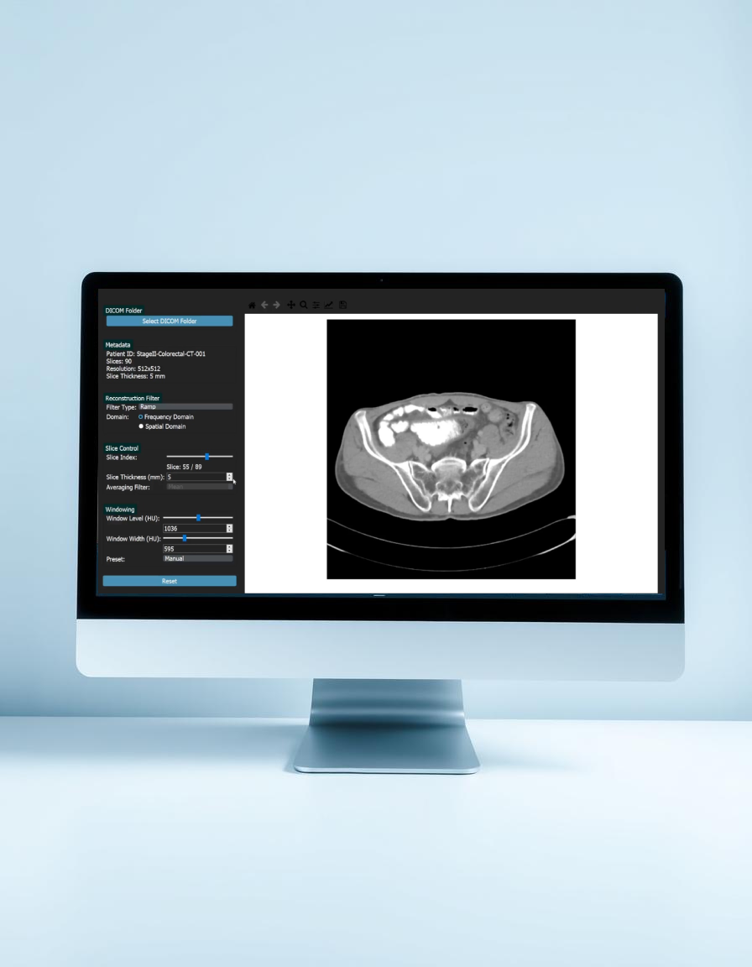
Interactive GUI Tool for CT Image Parameter Visualization
Team 4
Our tool allows users to load CT volumes and interactively adjust:
Reconstruction filters
Slice thickness
Windowing settings

Slide 2
Interactive GUI Tool for CT Image Parameter Visualization
Our tool allows users to load CT volumes and interactively adjust:
Reconstruction filters
Slice thickness
Windowing settings

Slide 3
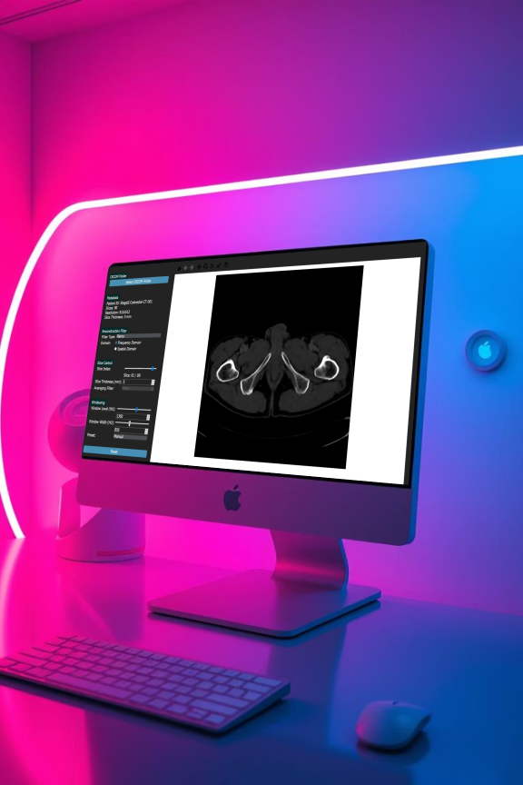
Project Overview and Objectives
01
Load and Process 3D CT Volumes
02
Interactive Parameter Controls
Users can load folders of DICOM files to form 3D volumes for analysis.
Adjust reconstruction filters, slice thickness, and windowing settings in real time.
03
Visualization and Export
Navigate slices, view metadata, and export processed images for further use.

Slide 4
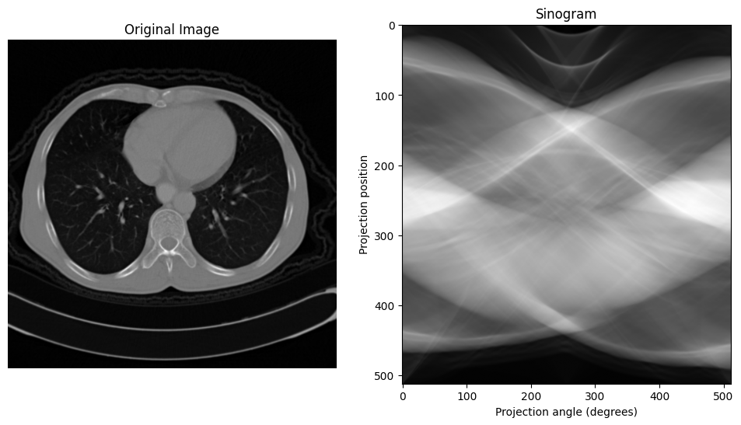
Theoretical Background
Back-Projection
Filter
Filtered Sinogram

Slide 5
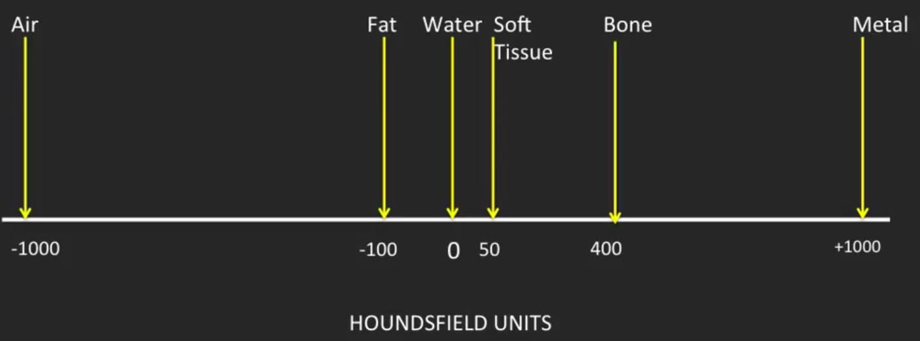
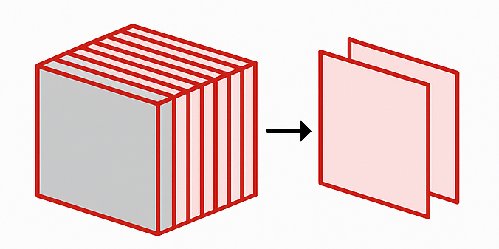
Slice Thickness and Windowing Parameters
Slice Thickness Effects
Thicker slices reduce noise but lower resolution; thinner slices improve resolution but increase noise.
WL
Thicker: Averaging with Mean, Gaussian, Median filters
Thinner: Interpolation to increase slice count
WW
Windowing (WL/WW)
Maps Hounsfield Units to grayscale for contrast and brightness control.
Window Level (WL): Brightness center
Window Width (WW): Contrast range
Presets for Brain, Liver, Bone, Soft Tissue

Slide 6




Implementation Details and Software Stack
Technologies Used
GUI Architecture
Core Workflow
Python 3, PyQt5 for GUI
Control panel for parameter selection and metadata display; image display area for processed slices.
Load DICOM folder, adjust parameters, real-time image update, export processed slices.
Matplotlib for visualization
NumPy, pydicom, Scikit-image for processing

Slide 7
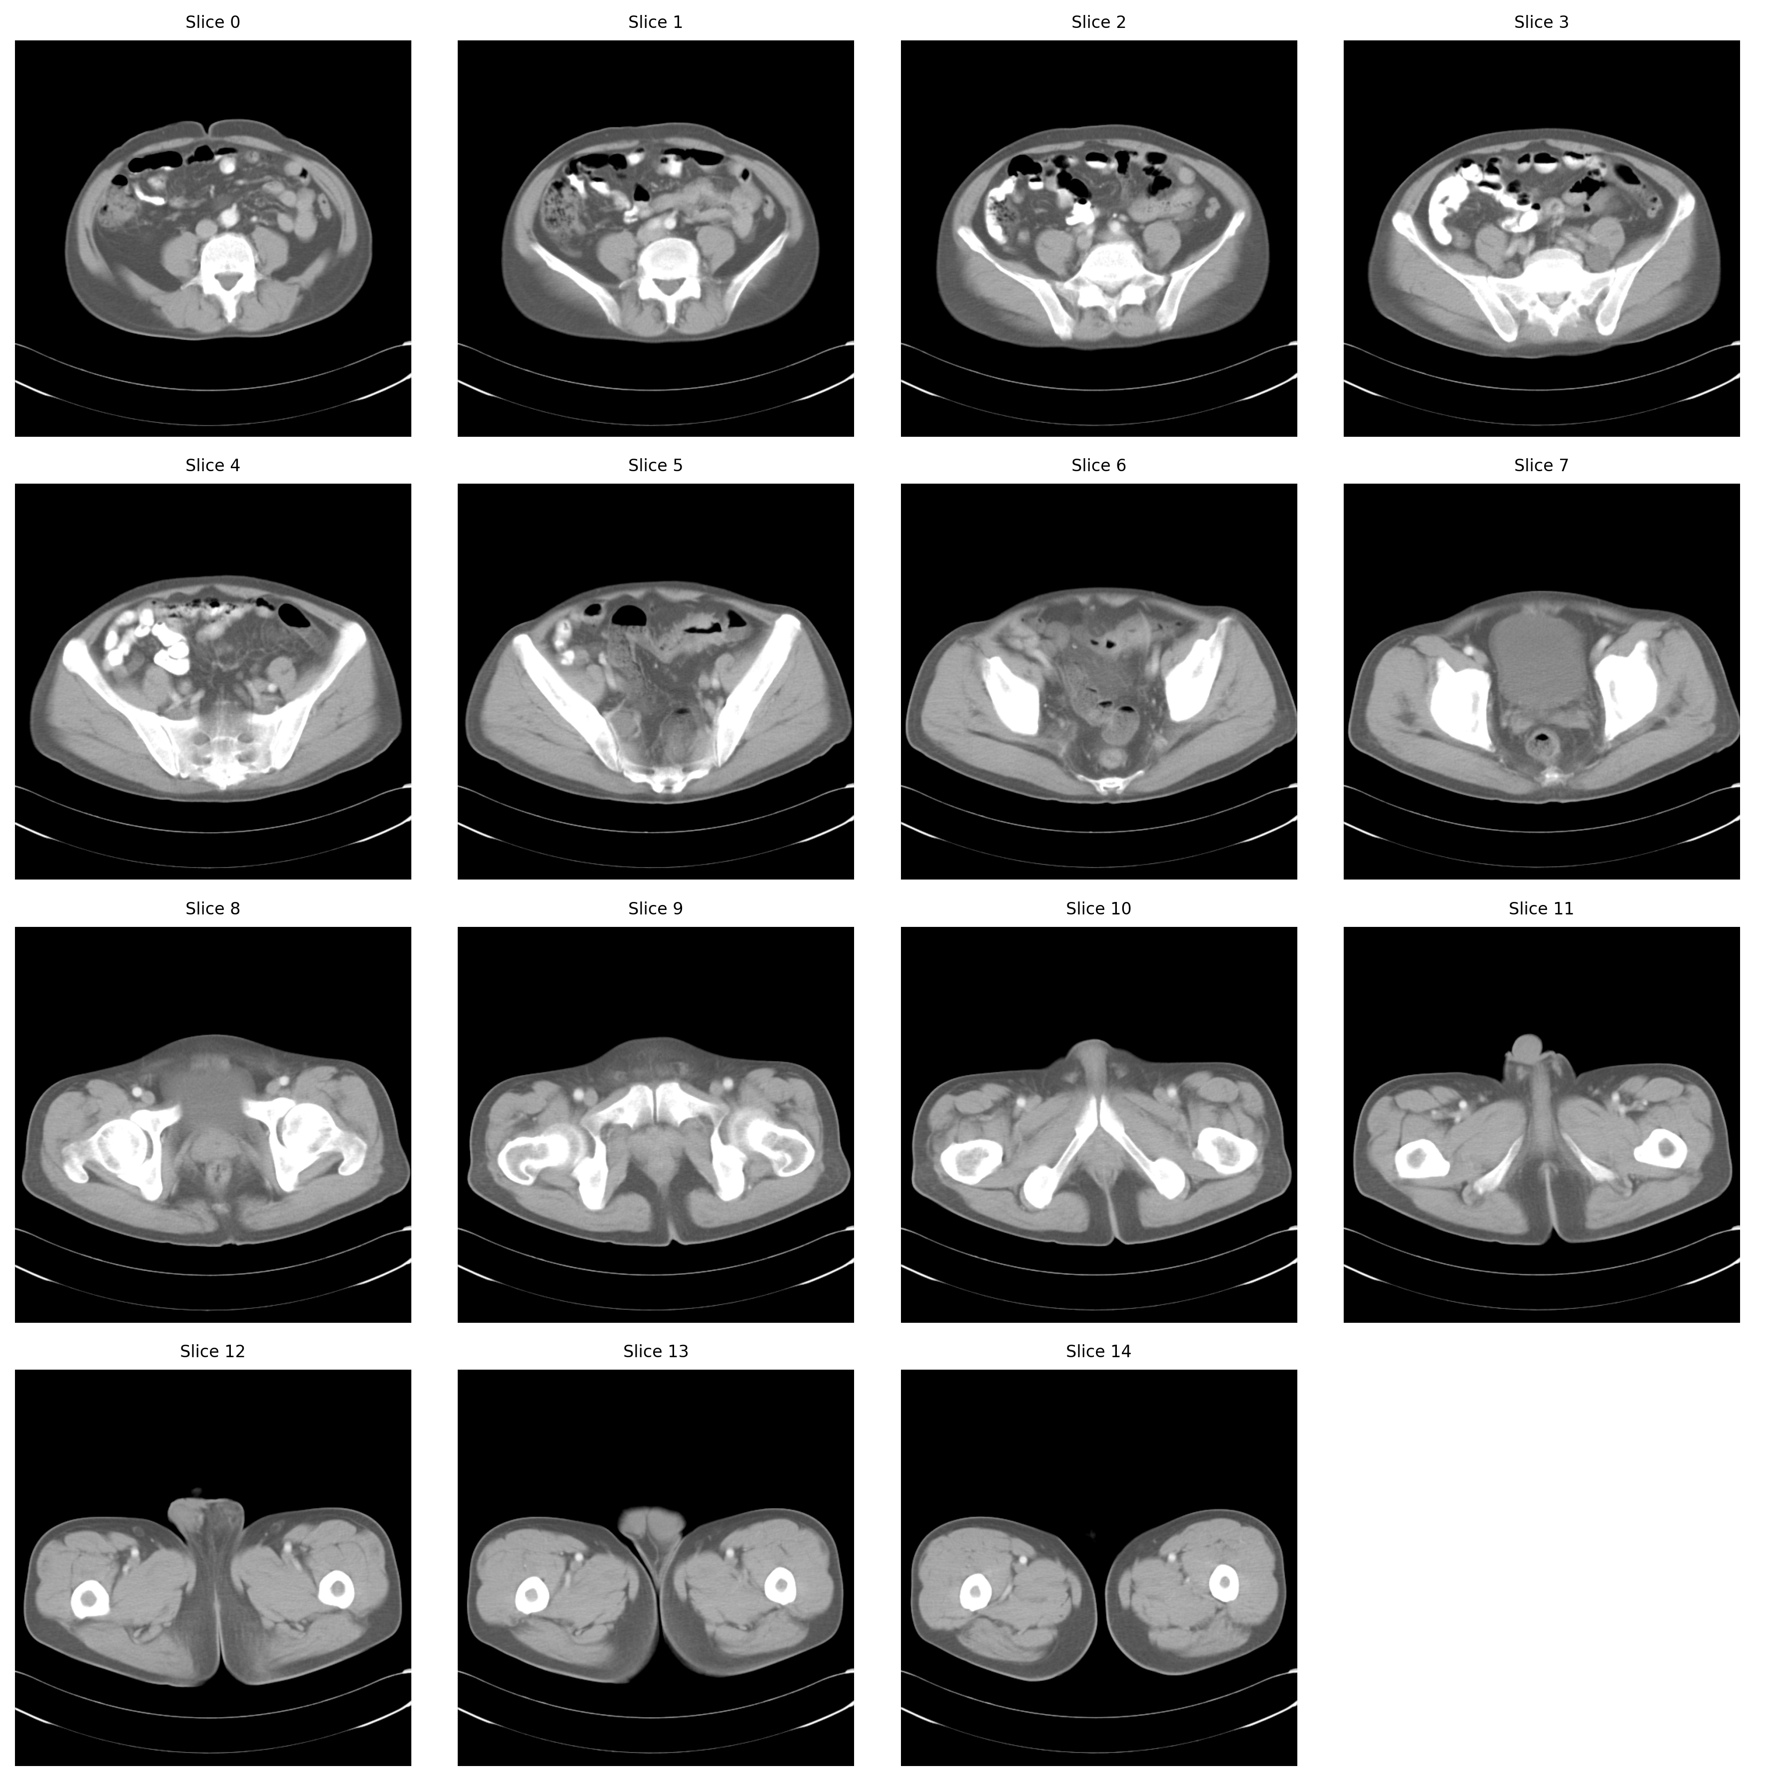
Export Functionality and User Feedback
Error Handling
Export Features
Alerts for invalid DICOM folders, input validation.
Export all processed slices as tiled PNG images with slice indexing for traceability.
User Feedback
Progress dialogs during interpolation and averaging to enhance user experience.

Slide 8
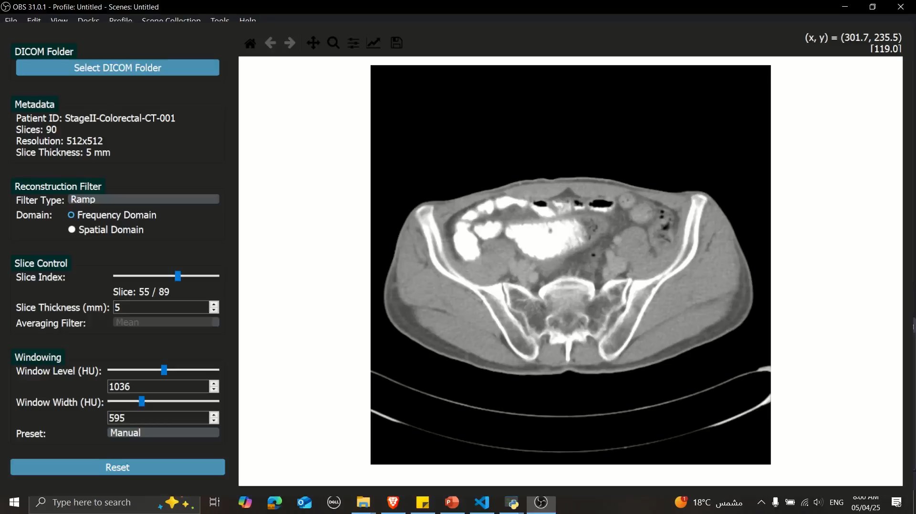

Slide 9
Thank You from Our Project Team
Amgad Atef
Ahmed Kamal
Mohamed Sami
Mohamed Sayed
Ziyad Hossam
GitHub Repo

